Slide 1
Antigenic distance and breadth of vaccine response
W. Zane Billings, Amanda L. Skarlupka, Ted M. Ross, Andreas Handel
slides at: https://wzbillings.com/presentations/
email me at: wesley.billings@uga.edu

Slide 2
Acknowledgements
Thanks to: Lambodhar Damodaran, Bingyi Yang
CEIRR (CIDER), CIVIC (CIVR-HRP) for funding
Figures created with biorender.com
Notes:
CIVIC and CEIRR funding, coauthors

Slide 3
Overview
Introduction and motivation
Proposed method
Simulation study
Real data analysis with UGAFluVac data
Some fun little case studies (time permitting)

Slide 4
Overarching questions
How can we convince you that our method is useful?
What do you want to see to show that our method is valid?

Slide 5
Part 1: Background

Slide 6
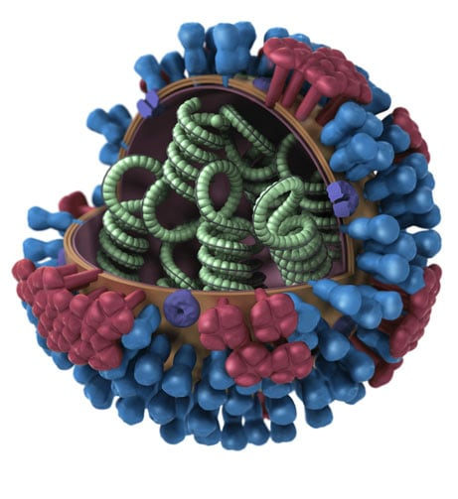
Image from https://www.cdc.gov/flu/about/viruses-types.html
The universal flu vaccine

Slide 7
Recombinant
Stem-based
Adjuvanted
High dose
…and others!
🤔
Which next-gen broadly reactive
influenza vaccine do I get?

Slide 8
How do we measure breadth of response?
We need to somehow measure individual responses to many strains.

Slide 9
How do we measure breadth of response?
We need to somehow measure individual responses to many strains.
Not possible to do traditional challenge studies.

Slide 10
How do we measure breadth of response?
We need to somehow measure individual responses to many strains.
Not possible to do traditional challenge studies.
So we recruit a cohort and take a panel of immunological measurements (correlates of protection) from each individual.

Slide 11
How do we measure breadth of response?
We need to somehow measure individual responses to many strains.
Not possible to do traditional challenge studies.
So we recruit a cohort and take a panel of immunological measurements (correlates of protection) from each individual.
Could be any (combination of) CoP(s) as long as we measure many strains.

Slide 12
How do we measure breadth of response?
We need to somehow measure individual responses to many strains.
Not possible to do traditional challenge studies.
So we recruit a cohort and take a panel of immunological measurements (correlates of protection) from each individual.
Could be any (combination of) CoP(s) as long as we measure many strains.
(Everything in this presentation is HAI since that’s the data
we have right now.)

Slide 13
New future assay?
The multiplex assay seems like a promising way to analyze many strains at once.
Everything we discuss will be about HAI, but the new assay should be a drop-in replacement to our method.
True for (theoretically) any assay e.g. ELISA or NAI.
Loes AN, et al. High-throughput sequencing-based neutralization assay reveals how repeated vaccinations impact titers to recent human H1N1 influenza strains. J Virol. 2024 Oct 22;98(10):e0068924. doi: 10.1128/jvi.00689-24. Epub 2024 Sep 24. PMID: 39315814; PMCID: PMC11494878.

Slide 14
OK, we ran the cohort study… What do we do with the titers we collect?

Slide 15
Magnitude: response to the homologous strain.
Breadth: responses to heterologous strains.
Overall strength: can we combine magnitude and breadth into one measurement of vaccine “strength” or “goodness”?
Notes:
Motivation slide about comparing universal vaccine candidates from different groups, move these slides to later.

Slide 16
Magnitude: response to the homologous strain.
Breadth: responses to heterologous strains.
Overall strength: can we combine magnitude and breadth into one measurement of vaccine “strength” or “goodness”?

Slide 17
Magnitude: response to the homologous strain.
Breadth: responses to heterologous strains.
Overall strength: can we combine magnitude and breadth into one measurement of vaccine “strength” or “goodness”?

Slide 18
Current methods
Notes:
Before this, introduce magnitude/breath

Slide 19
How do we measure the response?
Magnitude: geometric mean titer of homologous responses.
$exp\left(\frac{1}{n}\sum_{i=1}^{n}{\ln{{titer}_{i, j=0}}}\right)$

Slide 20
How do we measure the response?
Magnitude: geometric mean titer of homologous responses.
$exp\left(\frac{1}{n}\sum_{i=1}^{n}{\ln{{titer}_{i, j=0}}}\right)$
Breadth: seroconversion rate across all strains
$\frac{1}{n}\sum_{i=1}^{n}{\sum_{j=0}^{k}{I\left({seroconverted}_{i,j}\right)}}$

Slide 21
How do we measure the response?
Magnitude: geometric mean titer of homologous responses.
$exp\left(\frac{1}{n}\sum_{i=1}^{n}{\ln{{titer}_{i, j=0}}}\right)$
Breadth: seroconversion rate across all strains
$\frac{1}{n}\sum_{i=1}^{n}{\sum_{j=0}^{k}{I\left({seroconverted}_{i,j}\right)}}$
Overall strength: GMT across all strains.
$exp\left(\frac{1}{n}\sum_{i=1}^{n}{\sum_{j=0}^{k}{\ln{{titer}_{i, j}}}}\right)$

Slide 23
Magnitude
Total Strength
Breadth

Slide 24
Magnitude
Total Strength
Breadth

Slide 25
Selection of panel strains can completely change results even if nothing else changes!

Slide 26
Proposed method

Slide 27
Antibody landscape: titer vs. antigenic distance for all participants.
Notes:
Make sure to say that there are different ways to get antigenic distance.

Slide 28
Antigenic distance: how different are two strains?
Recognition
Temporal method: absolute difference in years of strain isolation.
Sequence method: based on genetic or protein sequence comparison.
E.g. Hamming distance or p-Epitope
Biochemical or evolutionary weighted methods like Grantham distance.
Antigenic cartography: use previously computed ferret maps or build our own.
No recognition

Slide 29
Sidenote: we are developing a pipeline to calculate all these distances and share our results.

Slide 30
Magnitude: regression line intercept
Notes:
Try to tie back to other measures

Slide 31
Breadth: prop. of line above threshold

Slide 32
Total strength: area under the curve
Notes:
Tie back to current metrics!!

Slide 33
We predict this will be robust across multiple panels!

Slide 34
We expect our methods to be more robust across multiple labs.
 | Current method | Proposed method
Magnitude | Homologous GMT | Intercept
Breadth | Overall SCR | Fraction above threshold
Overall strength | Overall GMT | AUC

Slide 35
How do we show that AUC is more robust than GMT across strains?
Simulation study: generate simulated “lab studies” based on our model assumptions and see if AUC is more robust (and when our assumptions fail).
Subsampling analysis: using UGAFluVac data, subsample multiple smaller studies with different panels and calculate metrics on each.

Slide 36
Part 2: Simulation Study

Slide 37
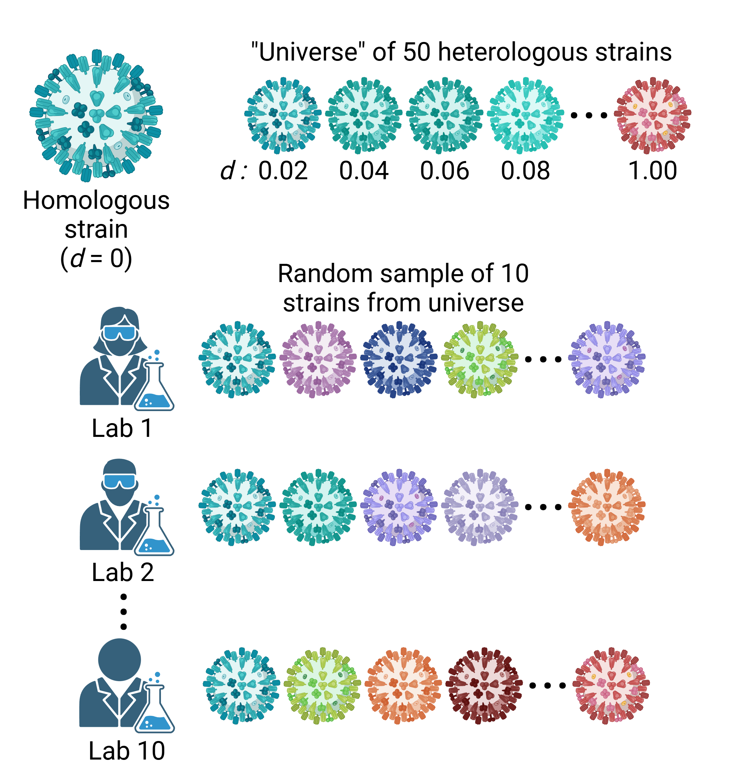
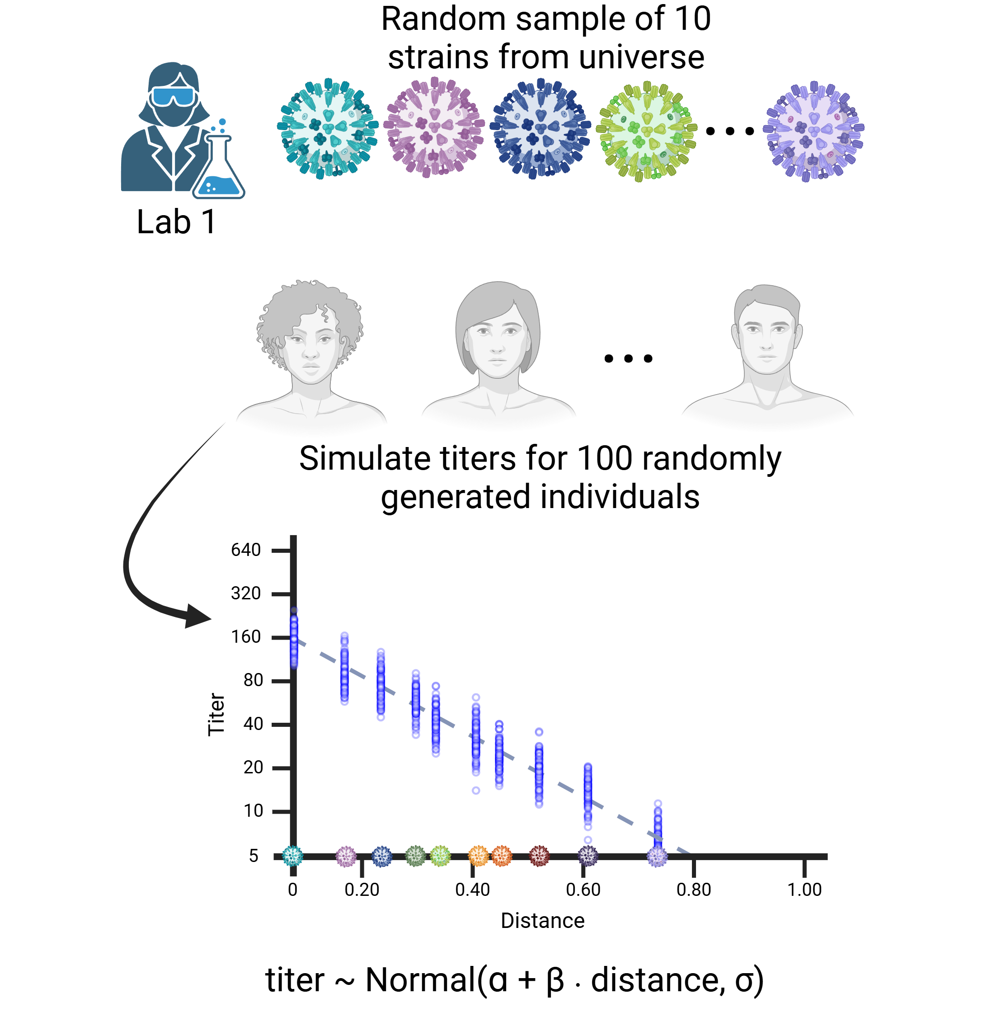
K

Slide 38
Next we join the MLM downline
Multilevel modeling: we fit a model where slope and intercept vary by individuals and used pooled estimates to adjust for between-subjects variance (aka hierarchical, mixed effects).

Slide 39
Next we join the MLM downline
Multilevel modeling: we fit a model where slope and intercept vary by individuals and used pooled estimates to adjust for between-subjects variance (aka hierarchical, mixed effects).

Slide 40
Next we fit the model to the data
Multilevel modeling: we fit a model where slope and intercept vary by individuals and used pooled estimates to adjust for between-subjects variance (aka hierarchical, mixed effects).

Slide 41
Next we fit the model to the data
Multilevel modeling: we fit a model where slope and intercept vary by individuals and used pooled estimates to adjust for between-subjects variance (aka hierarchical, mixed effects).
We fit independent models for each subtype and season
$y_{i,s}=β_{0}+b_{i,0}+\left(β_{1}+b_{i,1}\right)∙{distance}_{s}+ε_{i,s}$
$i=1, …n$ indexes subjects; $s=1,…,S$ indexes strains

Slide 42
Next we fit the model to the data
Multilevel modeling: we fit a model where slope and intercept vary by individuals and used pooled estimates to adjust for between-subjects variance (aka hierarchical, mixed effects).
We fit independent models for each subtype and season
$y_{i,s}=β_{0}+b_{i,0}+\left(β_{1}+b_{i,1}\right)∙{distance}_{s}+ε_{i,s}$
$i=1, …n$ indexes subjects; $s=1,…,S$ indexes strains
Censoring correction: the limit of detection and binning inherent to HAI and other lab assays can create false uncertainty, so we correct the estimated likelihood for censoring.

Slide 43
Intraclass correlation measures between vs. within group variance
Low ICC: within > between
(groups don’t explain variation)
High ICC: between > within
(groups vary together)
Images from Wikimedia
By Skbkekas - Own work, CC BY-SA 3.0,
https://commons.wikimedia.org/w/index.php?curid=6982834

Slide 44
Simulation study ICCs
AUC (our metric):
ICC: 0.52 (0.42, 0.60)
GMT (standard metric):
ICC: 0.92 (0.90, 0.94)

Slide 45
Simulation study ICCs
AUC (our metric):
Labs explain ~50% of variation
GMT (standard metric):
Labs explain ~90% of variation

Slide 46
In the simulation, AUC looks more robust to subsample than across-strain GMT!

Slide 47
Part 3: Real Data Analysis

Slide 48
UGAFluVac dataset
Led by Ted Ross, part of DIVERsity
Collected a panel of historical HAI assays from 2013/14 – 2017/18.

Slide 49
2016/17 H1N1 antibody landscape

Slide 50
2016/17 H1N1 antibody landscape
Observed HAI data (jittered)
(Predictions)
95% CI
Posterior mean

Slide 51
Subsampling methods
Pick a subcohort from one season (so there’s no vaccine changes), treat all four subtypes in the vaccine separately.
From full cohort, choose 9 heterologous strains and 100 individuals to create one subsample, add the homologous strain data as well.
Repeat this 25 times to get 25 “studies”.
Follow analysis strategy for simulations – fit a multilevel model, get AUC and GMT samples, calculate ICC.

Slide 52
Real data subsampling ICCs
AUC (our metric):
ICC: 0.44 (0.22, 0.64)
GMT (standard metric):
ICC: 0.91 (0.82, 0.95)

Slide 53
If we account for censoring, the real data match the simulation!
Data not shown: not accounting for censoring falsely reduces the variance of both measures, but seems to reduce GMT variance more.

Slide 54
Example: HD vs SD
We show data for 2016/17 flu season only
Only included individuals 65 and older who were allowed to choose a high dose vaccine
We create 10 “studies”, i.e. subsampled panels of strains.
There were only 34 people ≥65, so we subsampled 30 SD and 30 HD subjects per subsampled study. (This will make our subsamples more correlated, unfortunately.)
Which vaccine would each conclude is more broadly reactive if they used GMT, and if they used AUC?

Slide 55
Some subsamples would change conclusions, but all have high uncertainty

Slide 56
Some subsamples would change conclusions, but all have high uncertainty
Higher sample size would help out here.
Other seasons or pooling seasons together could be useful.
Some point estimates do change, so it seems reasonable to say that the metric matters!

Slide 57
Future directions with AUC
Compare multiple distance measures to see which seem best / most predictive of a good vaccine candidate.
Explore summary landscape – is a linear model good enough?

Slide 58
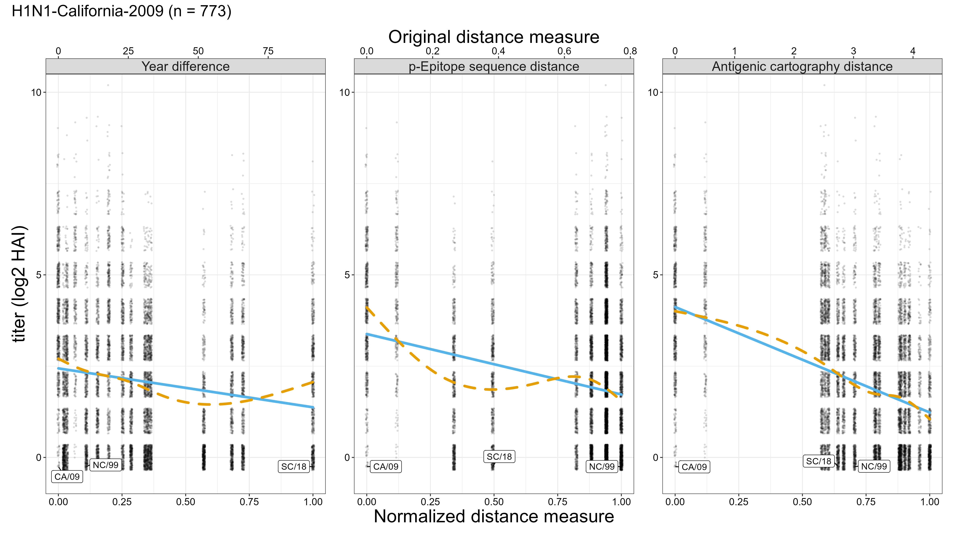

Slide 59
Future directions with AUC
Compare multiple distance measures to see which seem best / most predictive of a good vaccine candidate.
Explore summary landscape – is a linear model good enough?
Experiment with weighting schemes.

Slide 60
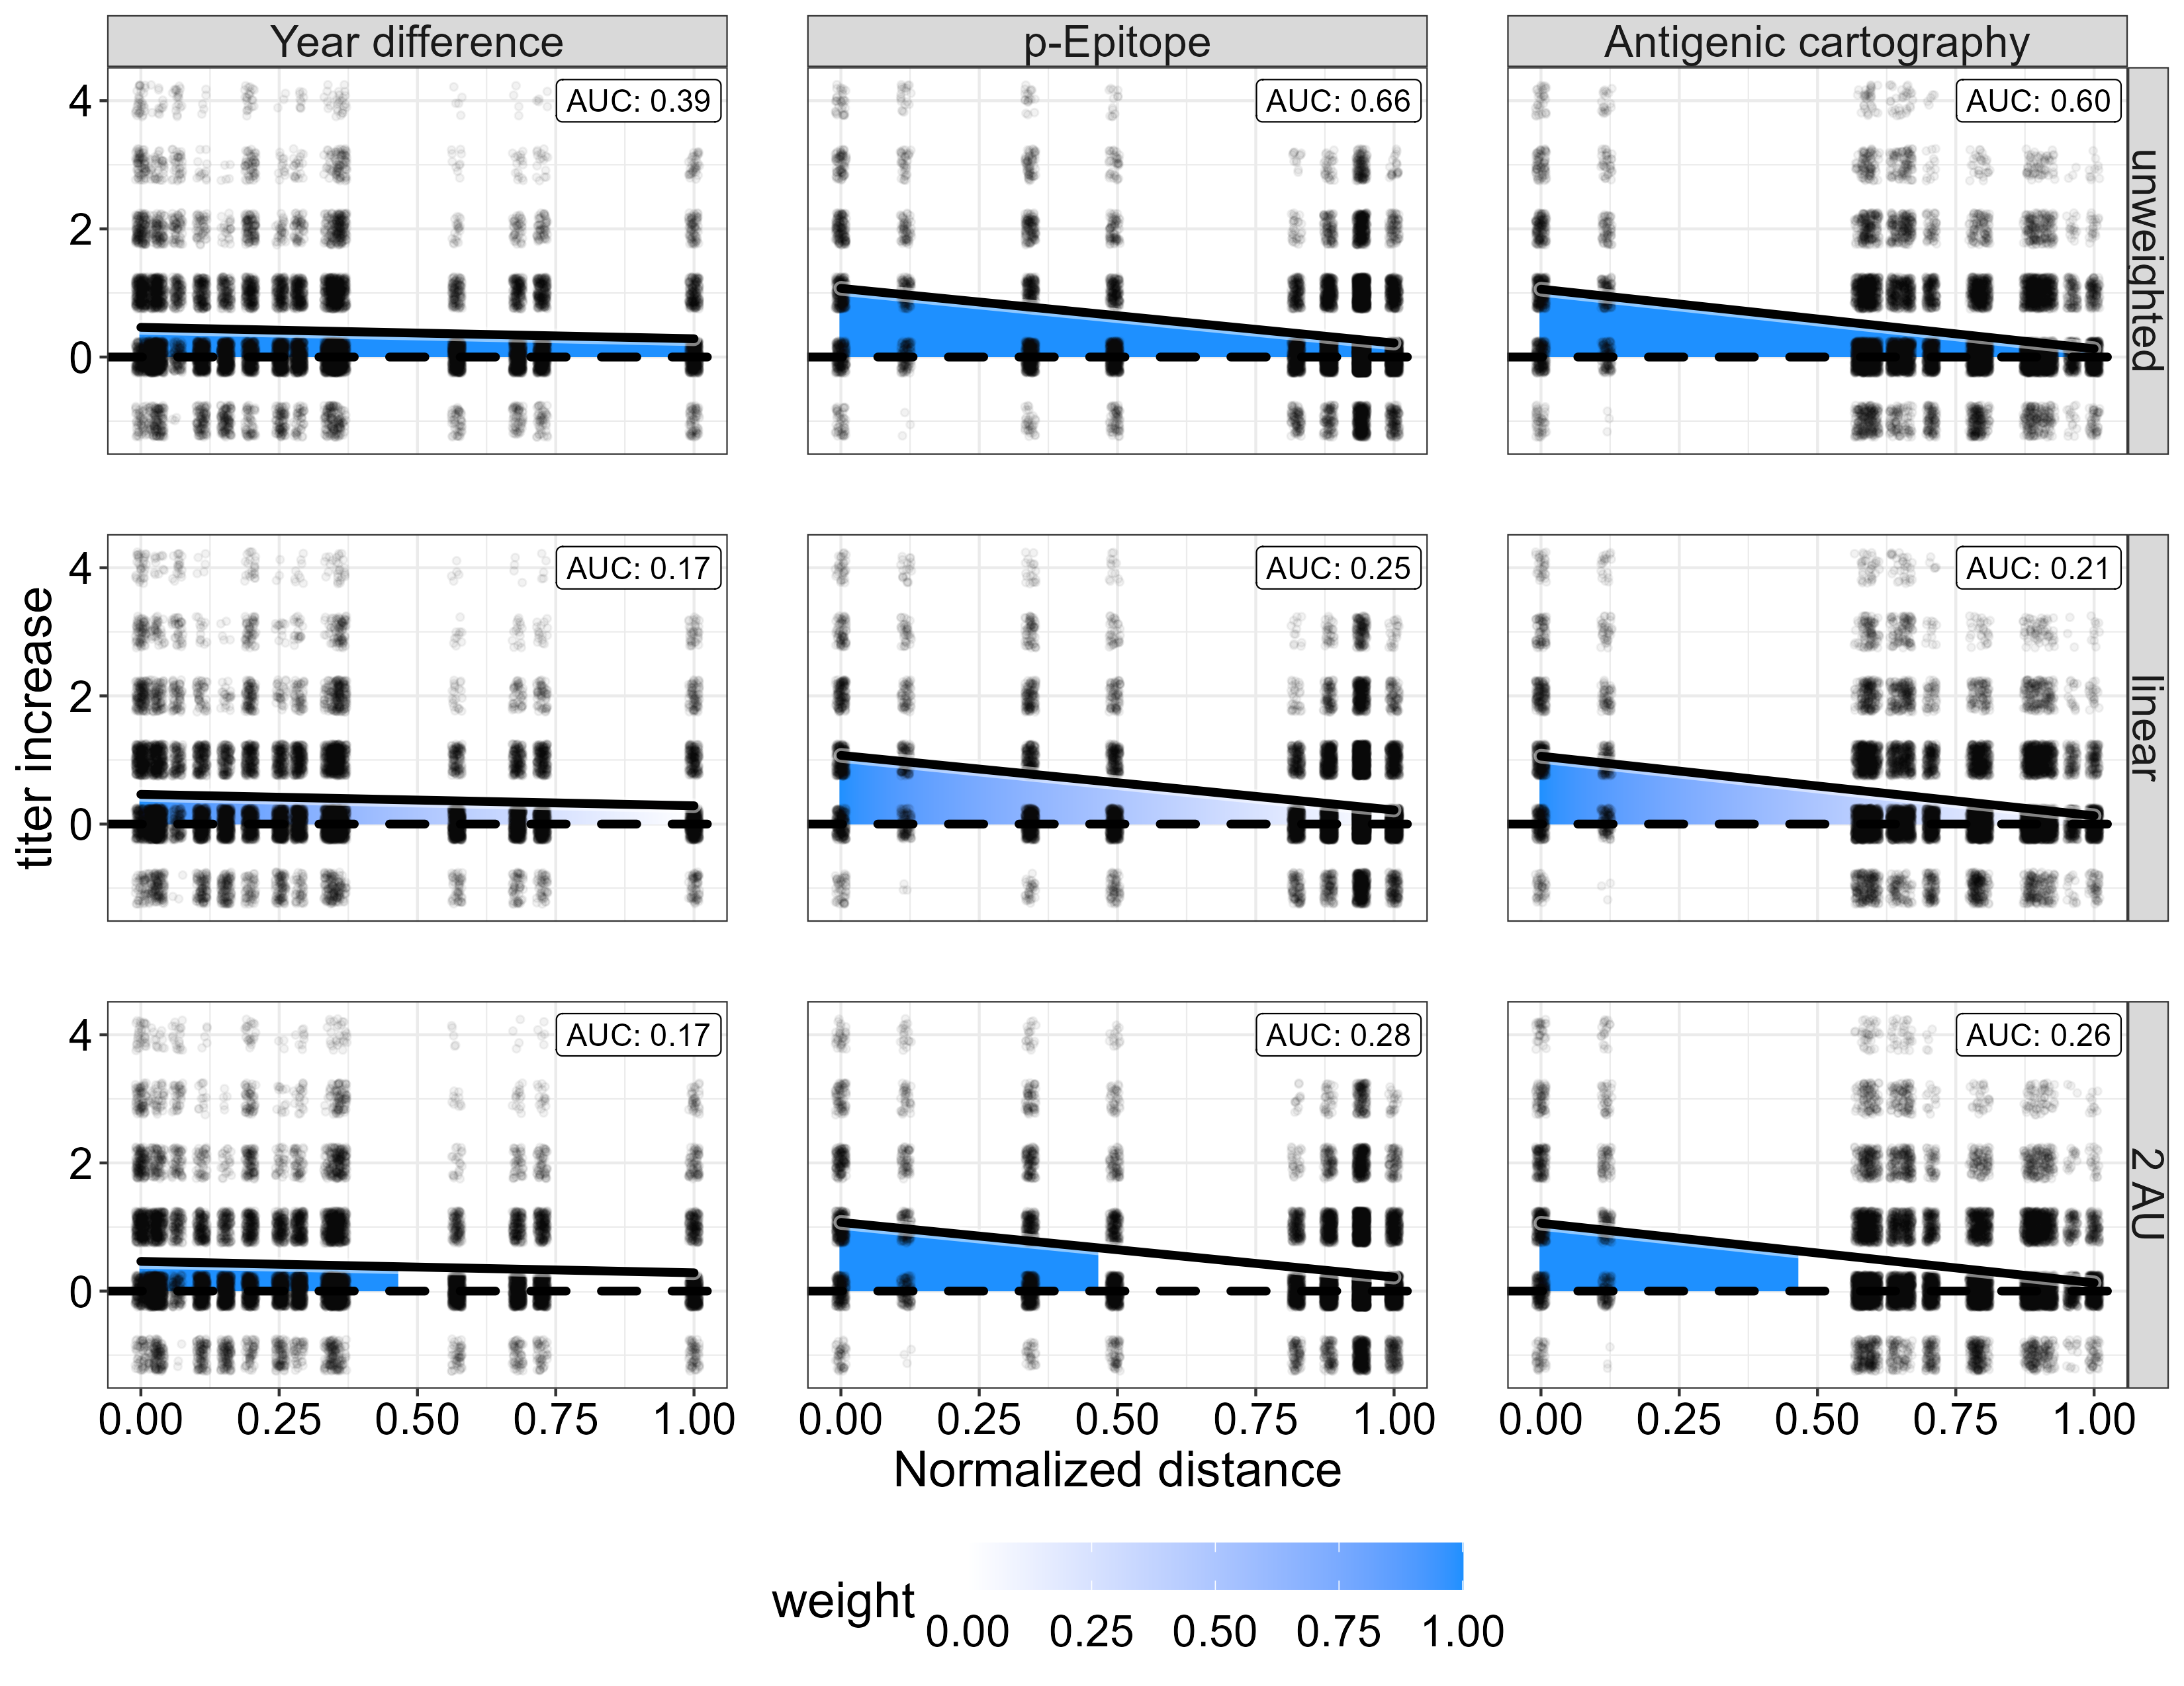

Slide 61
Future directions with AUC
Compare multiple distance measures to see which seem best / most predictive of a good vaccine candidate.
Explore summary landscape – is a linear model good enough?
Experiment with weighting schemes.
We need heterologous data that tests old serum samples against “future” strains to really test our hypotheses.
E.g. take serum samples from 2016/17, test HAI against MI/15, Brisbane/18, GM/19, …. and so on.

Slide 62
Final thoughts
Correct for censoring and don’t use year-based difference
AUC seems to be more robust to the panel sampling problem than current methods
Variance components (from multilevel models) seem to be a useful approach to understand sampling variation
E.g. analyzing how important between-individual variation is
Understanding the causal effect of distance could help us use distance for vaccine selection.

Slide 63
WIP: variance partitioning (time permitting)

Slide 64
WIP: variance partitioning
Approach 1: model variance components

Slide 65
WIP: variance partitioning
Approach 1: model variance components
Within vs. between lab variation as we showed
Multiple sources of sampling variation: individuals, labs, vaccines

Slide 66
WIP: variance partitioning
Approach 1: model variance components
Within vs. between lab variation as we showed
Multiple sources of sampling variation: individuals, labs, vaccines
Approach 2: variance in posterior predictions

Slide 67
WIP: variance partitioning
Approach 1: model variance components
Within vs. between lab variation as we showed
Multiple sources of sampling variation: individuals, labs, vaccines
Approach 2: variance in posterior predictions
Compare variation explained by observed effects vs. random variation
Emily’s question about interindividual variance

Slide 68
Approach 1: variance components
$$y_{ijk…}=Xβ+b_{subject[i]}+b_{lab\left[j\right]}+b_{vaccine[k]}+⋯+ε_{ijk…}$$
$$b_{whatever} \sim Normal\left({0,σ}_{whatever}^{2}\right)$$
$$ε_{ijk…} \sim Normal\left(0,σ^{2}\right)$$

Slide 69
Approach 1: variance components
$$y_{ijk…}=Xβ+b_{subject[i]}+b_{lab\left[j\right]}+b_{vaccine[k]}+⋯+ε_{ijk…}$$
$$b_{whatever} \sim Normal\left({0,σ}_{whatever}^{2}\right)$$
$$ε_{ijk…} \sim Normal\left(0,σ^{2}\right)$$

Slide 70
Approach 1: variance components
$$y_{ijk…}=Xβ+b_{subject[i]}+b_{lab\left[j\right]}+b_{vaccine[k]}+⋯+ε_{ijk…}$$
$$b_{whatever} \sim Normal\left({0,σ}_{whatever}^{2}\right)$$
$$ε_{ijk…} \sim Normal\left(0,σ^{2}\right)$$
I promise it isn’t as scary as it looks!

Slide 71
Approach 1: variance components
$$y_{ijk…}=Xβ+b_{subject[i]}+b_{lab\left[j\right]}+b_{vaccine[k]}+⋯+ε_{ijk…}$$
$$b_{whatever} \sim Normal\left({0,σ}_{whatever}^{2}\right)$$
$$ε_{ijk…} \sim Normal\left(0,σ^{2}\right)$$
I promise it isn’t as scary as it looks!
Right now, we only have data from one lab.
But we can add between-lab variance in simulations.

Slide 72
Approach 2: Effect of individual variation
$$y_{i,s}=β_{0}+b_{i,0}+\left(β_{1}+b_{i,1}\right)∙{distance}_{s}+ε_{i,s}$$
Betas: population effects for intercept and distance
Little b’s: each individual gets their own effect representing departure from the population intercept and effect of distance.
Fit model, get (counterfactual) predictions on dataset.

Slide 73
Approach 2: Effect of individual variation
$$y_{i,s}=β_{0}+b_{i,0}+\left(β_{1}+b_{i,1}\right)∙{distance}_{s}+ε_{i,s}$$
Betas: population effects for intercept and distance
Little b’s: each individual gets their own effect representing departure from the population intercept and effect of distance.
Fit model, get (counterfactual) predictions on dataset.
$$∆_{σ}=\frac{Var\left({\hat{β}}_{0}+0+\left({\hat{β}}_{1}+0\right)∙distance\right)}{Var\left({\hat{β}}_{0}+{\hat{b}}_{i,0}+\left({\hat{β}}_{1}+{\hat{b}}_{i,1}\right)∙distance\right)}$$

Slide 74
Approach 2: Effect of individual variation
$$y_{i,s}=β_{0}+b_{i,0}+\left(β_{1}+b_{i,1}\right)∙{distance}_{s}+ε_{i,s}$$
Betas: population effects for intercept and distance
Little b’s: each individual gets their own effect representing departure from the population intercept and effect of distance.
Fit model, get (counterfactual) predictions on dataset.
$$∆_{σ}=\frac{Var\left(all predictions ignoring random effects\right)}{Var\left(all predictions with random effects\right)}$$

Slide 75
Approach 2: Effect of individual variation
$$∆_{σ}=\frac{Var\left(all predictions ignoring random effects\right)}{Var\left(all predictions with random effects\right)}$$
“Fraction of variance explained by fixed effects only”
Can provide insight about how important between-individual variance is, compared to observed effects like distance.
$∆_{σ}≈1→$ Including interindividual variance doesn’t do much.
$∆_{σ}≫1→$ Individual variance becomes more important than fixed effects.
If you do it Bayesian, you can get uncertainty estimates for free.

Slide 76
Interindividual variance in UGAFluVac
Var w/o RE: 3.11 (2.92, 3.28)
Var w/ RE: 4.32 (4.11, 4.52)
$∆_{σ}≈$ 72% (68%, 76%)
After including pre-titer:
Var w/o RE: 3.34 (3.20, 3.46)
Var w/ RE: 3.77 (3.66, 3.89)
$∆_{σ}≈$ 89% (86%, 92%)

Slide 77
Interindividual variance in UGAFluVac
Var w/o RE: 3.11 (2.92, 3.28)
Var w/ RE: 4.32 (4.11, 4.52)
$∆_{σ}≈$ 72% (68%, 76%)
After including pre-titer:
Var w/o RE: 3.34 (3.20, 3.46)
Var w/ RE: 3.77 (3.66, 3.89)
$∆_{σ}≈$ 89% (86%, 92%)

Slide 78
Interindividual variance in UGAFluVac
Var w/o RE: 3.11 (2.92, 3.28)
Var w/ RE: 4.32 (4.11, 4.52)
$∆_{σ}≈$ 72% (68%, 76%)
After including pre-titer:
Var w/o RE: 3.34 (3.20, 3.46)
Var w/ RE: 3.77 (3.66, 3.89)
$∆_{σ}≈$ 89% (86%, 92%)

Slide 79
Interindividual variance in UGAFluVac
Var w/o RE: 3.11 (2.92, 3.28)
Var w/ RE: 4.32 (4.11, 4.52)
$∆_{σ}≈$ 72% (68%, 76%)
After including pre-titer:
Var w/o RE: 3.34 (3.20, 3.46)
Var w/ RE: 3.77 (3.66, 3.89)
$∆_{σ}≈$ 89% (86%, 92%)
Some seasons/subtypes showed
larger differences!

Slide 80
Extra info

Slide 81
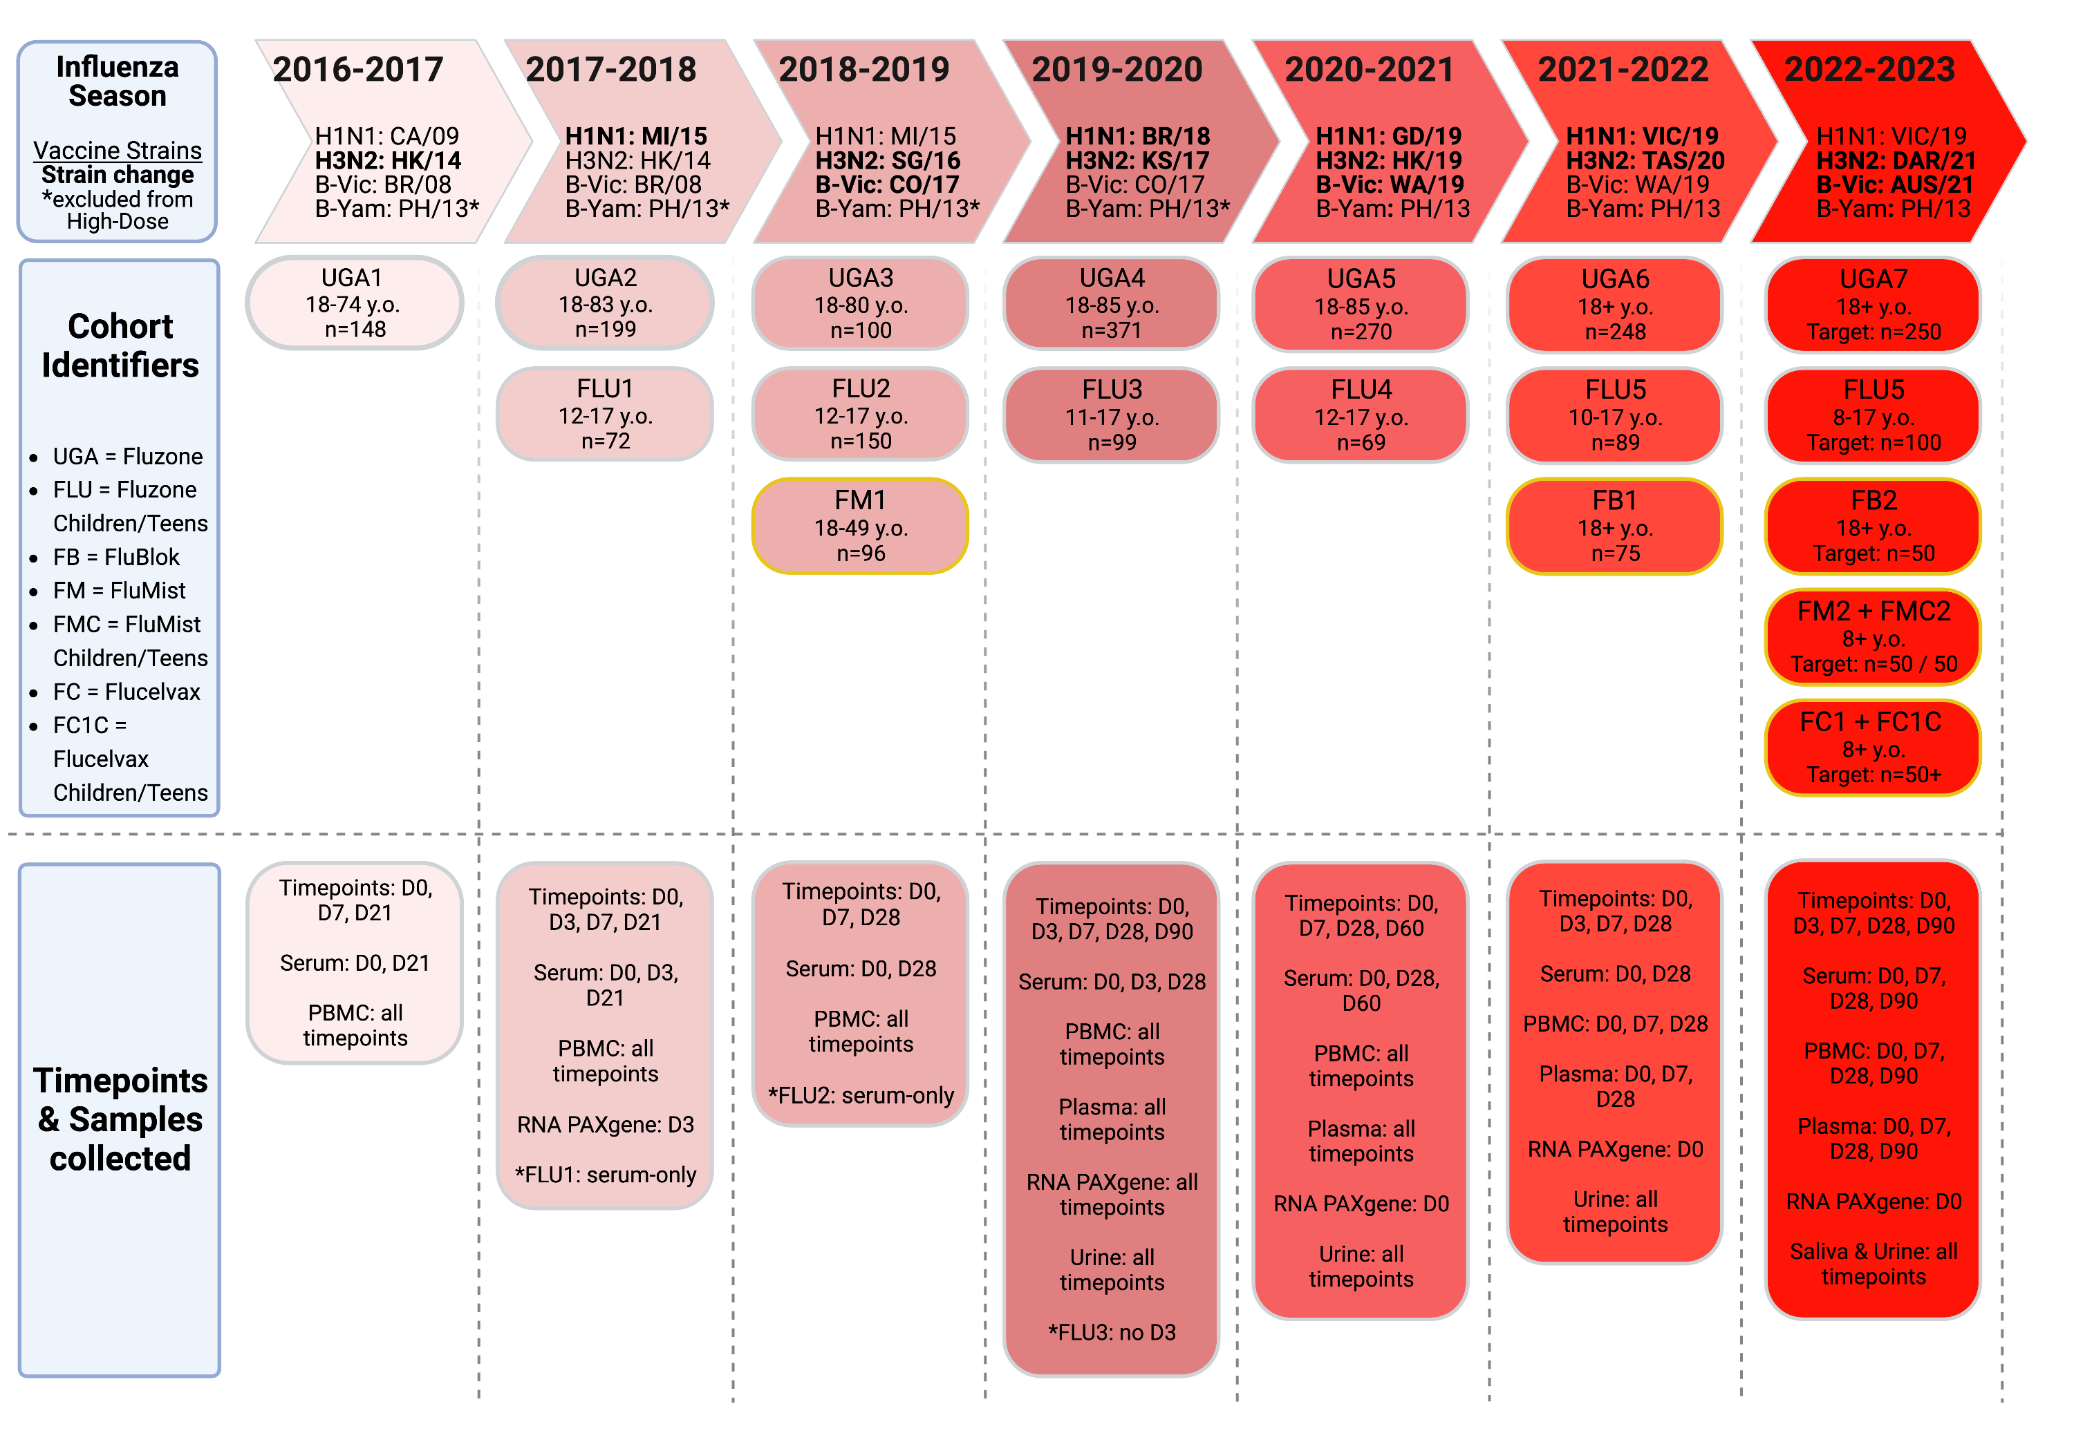
“UGAFluVac”: this, plus a similar study from 2013 – 2016 also by Ted Ross
Notes:
Brief intermission for data description

Slide 82
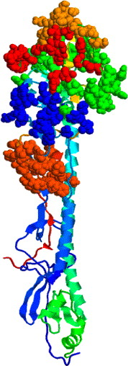
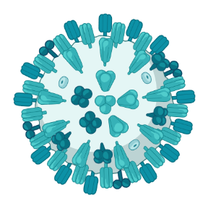
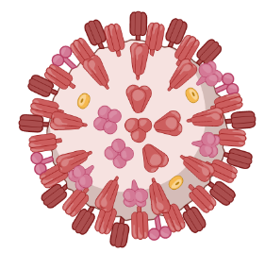
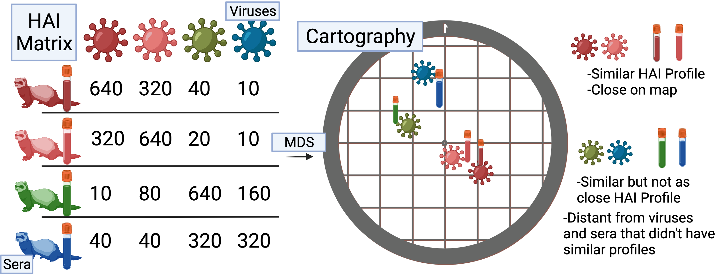
Antigenic distance
(dominant) p-Epitope method
Temporal method
A/H3N2/Aichi/2/1968
MKTIIALSYIF
MLTIIKLSYLF
|2017 – 1968| = 49
Hamming distance = 3
p-Epitope = 3/11 = 0.27
(I made this sequence up)
A/H3N2/Kansas/14/2017
Antigenic cartography method
Protein structure from Gupta, Earl, and Deem. Vaccine 2006.
Cartography figure made by Amanda Skarlupka.

Slide 83
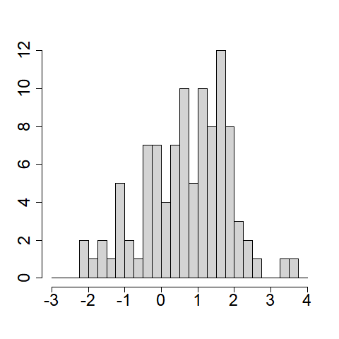
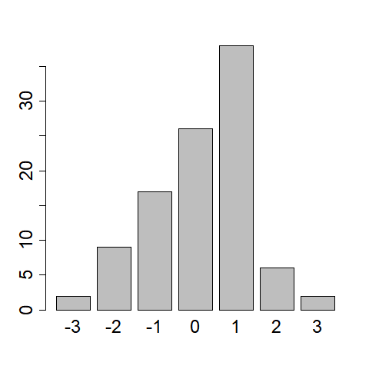
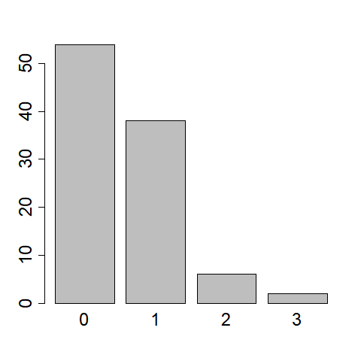
Interval censoring
Left censoring
Continuous “underlying”
titer
Floored titer
(round down)
Floored titer
with LoD
Notes:
Need to explain what censoring is if I’m going to say that. Or stick to LoD.

Slide 84
ICC Calculation
Calculate AUC or GMT for each lab/subsample
Fit another mixed-effects model (this is a computational trick to easily get the variances we need)
Calculate ICC from variances:
Get a bootstrap CI for frequentist model*, or if you do it Bayesian you get posterior distributions of variances.
$$AUC or GMT=β_{0}+ b_{lab}+ε; b_{lab}\sim Normal\left(0,σ_{lab}^{2}\right); ε\sim Normal(0,σ^{2})$$
$$\hat{ICC}=\frac{{\hat{σ}}_{lab}^{2}}{{\hat{σ}}_{lab}^{2}+{\hat{σ}}^{2}}$$
*You probably need more labs or you’ll get a
boundary convergence error and I would cry

Slide 85
HD/SD comparison ICCs
ICC | GMT | AUC
HD | 0.77 (0.65, 0.87) | 0.62 (0.44, 0.74)
SD | 0.71 (0.30, 0.82) | 0.36 (0.20, 0.51)
Despite the high uncertainty in contrasts, AUC was still more robust for AUC than SD.
Metrics were more robust on SD data than HD? This could be sampling variation or an interesting lead.

Slide 86
Multilevel modeling
There is some “universe” of possible influenza strains that exist in different freezers around the world.
For a given subtype T = t and year Y = y, we can compute the antigenic distance between all of these strains and the vaccine component strain using one or more methods. Let D(s | t, y) map strain s to antigenic distance.
Every lab (l = 1, …, L) group that runs a heterologous data cohort study uses some subsample of these strains (s = 1, …, S_l) and measures titers for subjects i = 1, …, N_l.
Then, the post-vaccination titers for that lab group are y_i,s = f(D(s | t,y)) + g(covariates) + b_i + error.

Slide 87
Multilevel modeling
For now, we assume the effects of covariates are negligible and we assume the effect of distance is linear. Then our model is
y_i,s = b_0 + b_0,i + (b_1 + b_1,i) * D(s | t,y) + error_i,s
This is a linear mixed effects model and is estimable whenever we have at least two measurements per subject (per subtype per year).
The outcome y has left-censored (below LoD) measurements and interval censored measurements, so we apply a likelihood correction to adjust for censoring.
The effect of pre-vaccination titer is NOT negligible but might be ignorable for our purposes.

Slide 88
Approach 1: variance components
$$y_{ijk…}=Xβ+b_{subject[i]}+b_{lab\left[j\right]}+b_{vaccine[k]}+⋯+ε_{ijk…}$$
$$b_{whatever} \sim Normal\left({0,σ}_{whatever}^{2}\right)$$
$$ε_{ijk…} \sim Normal\left(0,σ^{2}\right)$$
Looks scary!

Slide 89
Approach 1: variance components
$$y_{ijk…}=Xβ+b_{subject[i]}+b_{lab\left[j\right]}+b_{vaccine[k]}+⋯+ε_{ijk…}$$
$$b_{whatever} \sim Normal\left({0,σ}_{whatever}^{2}\right)$$
$$ε_{ijk…} \sim Normal\left(0,σ^{2}\right)$$
Looks scary!
But it’s not too bad once you get past all the b’s.

Slide 90
Approach 1: variance components
Fixed effects
(regular regression part)
$$y_{ijk…}=Xβ+b_{subject[i]}+b_{lab\left[j\right]}+b_{vaccine[k]}+⋯+ε_{ijk…}$$
$$b_{whatever} \sim Normal\left({0,σ}_{whatever}^{2}\right)$$
$$ε_{ijk…} \sim Normal\left(0,σ^{2}\right)$$
Looks scary!
But it’s not too bad once you get past all the b’s.

Slide 91
Approach 1: variance components
Random (intercept) effects
(cool and fun part)
$$y_{ijk…}=Xβ+b_{subject[i]}+b_{lab\left[j\right]}+b_{vaccine[k]}+⋯+ε_{ijk…}$$
$$b_{whatever} \sim Normal\left({0,σ}_{whatever}^{2}\right)$$
$$ε_{ijk…} \sim Normal\left(0,σ^{2}\right)$$
Looks scary!
But it’s not too bad once you get past all the b’s.

Slide 92
Approach 1: variance components
$$y_{ijk…}=Xβ+b_{subject[i]}+b_{lab\left[j\right]}+b_{vaccine[k]}+⋯+ε_{ijk…}$$
$$b_{whatever} \sim Normal\left({0,σ}_{whatever}^{2}\right)$$
$$ε_{ijk…} \sim Normal\left(0,σ^{2}\right)$$
Residual unexplained variance
(the part that makes it statistics)

Slide 93
Approach 1: variance components
$$y_{ijk…}=Xβ+b_{subject[i]}+b_{lab\left[j\right]}+b_{vaccine[k]}+⋯+ε_{ijk…}$$
$$b_{whatever} \sim Normal\left({0,σ}_{whatever}^{2}\right)$$
$$ε_{ijk…} \sim Normal\left(0,σ^{2}\right)$$
All those (subjects/labs/whatevers) have some effect…
And it changes for each one
And we only have a subset of the possible subjects/labs/whatevers

Slide 94
Approach 1: variance components
$$y_{ijk…}=Xβ+b_{subject[i]}+b_{lab\left[j\right]}+b_{vaccine[k]}+⋯+ε_{ijk…}$$
$$b_{whatever} \sim Normal\left({0,σ}_{whatever}^{2}\right)$$
$$ε_{ijk…} \sim Normal\left(0,σ^{2}\right)$$
Sources of variation add together!

Slide 95
Approach 1: variance components
$$y_{ijk…}=Xβ+b_{subject[i]}+b_{lab\left[j\right]}+b_{vaccine[k]}+⋯+ε_{ijk…}$$
$$b_{whatever} \sim Normal\left({0,σ}_{whatever}^{2}\right)$$
$$ε_{ijk…} \sim Normal\left(0,σ^{2}\right)$$
Sources of variation add together!
$$Total variation in y|x= σ^{2}+\sum_{whatever}{σ_{whatever}^{2}}$$

